Slide 1
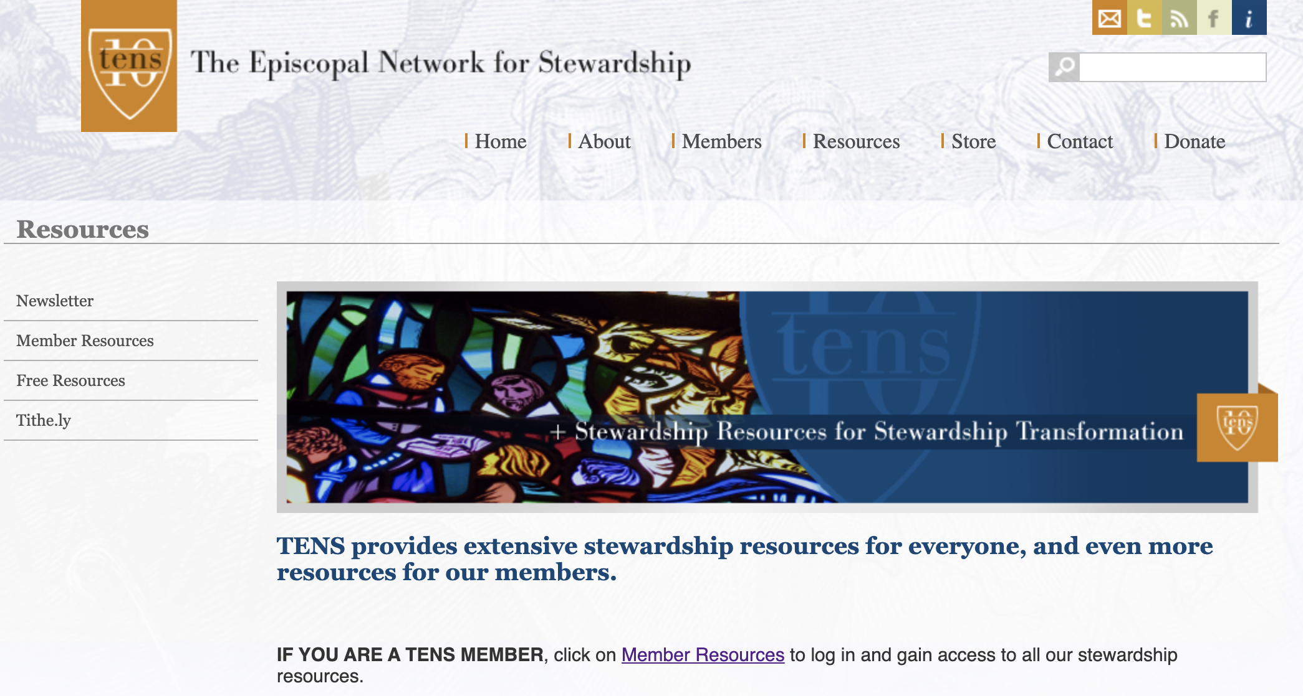
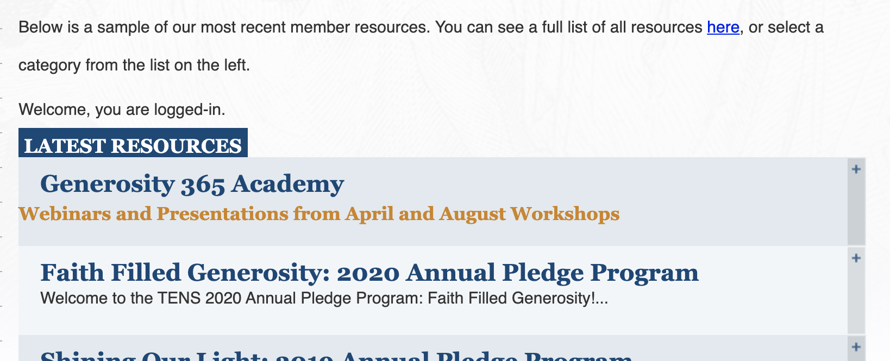
TENS www.tens.org
Username: 1Peter
PW: FOUR:10

Slide 2
As we have moved through Matthew’s Gospel this year, we have heard how Jesus teaches us to be in relationship with each other and with God
Our relationship with God begins with the Creation, and our ongoing role in the re-creation of the world given to us by God
Such abundance inspires our generosity – we may give much because we have been given much

Slide 3
Elements of the Campaign
Stewardship campaign guide for both virtual and in person
Letters from clergy and Senior Warden
Pledge Cards
Lectionary based reflections, beginning on October 4 through Christ the King Sunday
Logos
All resources available in Spanish and English
Resources are designed to be adapted to your context

Slide 4
During the Campaign
Kick-off Sunday
Some communities will begin on October 4. If yours is one that highlights Francis on his feast day, it may be more appropriate to do your kick-off the following week, October 11
After the principal service, hold a special virtual meeting to kick-off – introduce leadership, have a testimonial, review the campaign materials and case for giving
Oct 4-17 Send the next letter from either your wardens or your campaign chair along with your stewardship materials in post and in email
Weekly pledge-season inserts These will help you relate the readings each week to stewardship themes
Convene small groups however frequently your community can
Send the letter from the Rector near the end of the campaign.

Slide 5
Dedication/Ingathering Sunday
Use the first Sunday in Advent to announce your pledge totals. Celebrate!
Pay special attention during the Offertory to hold up pledge cards, bless them, offer them to God for the work of the Church
Have a virtual coffee hour to celebrate the good work you have accomplished
Thank campaign leadership
Thank volunteers who have made testimonials or done other work for the campaign
Remember the mission – talk about the great things that your congregation’s gifts will do for the community this year
Implement a follow-up plan to reach households who have not yet turned in their pledges

Slide 6
Using the Weekly Inserts
Related to assigned readings for the week. Frame the readings for stewardship themes
Theological and practical statements of faith and generosity
They can be used in a post-service virtual coffee hour as a forum for discussion, or in a weekly small-group meeting
Each reflection suggests a couple of questions designed to engage us on stewardship topics
The reflections can also serve as inspiration for a sermon on stewardship

Slide 7
Using small groups to build community
A powerful connection and deepening relationship is possible when members ask each other for their gifts or enter into dialogue about the mission and priorities of the church. Your stewardship campaign this year should create small groups focused on formation and mission. Small groups are the best way to develop meaningful formation about money and mission.
In times of physical distancing, small group meetings, led by members of the vestry, stewardship committee, or other lay leaders facilitate the education of mission and the teaching of good stewardship fundamentals.
Facilitated Small groups
House churches
Bible studies or topical studies
Money autobiographies
TENS has resources on how to set up and facilitate small groups online

Slide 8
Kicking Off in Community
Kick off Sunday is a great celebration!
Host a Virtual Coffee Hour following your Sunday Service(s)
Share testimonials – pre-recorded or pre-arranged via Zoom
Walk through this year’s materials and the case for giving
Include budget or narrative budget (or both!)
Include mission-related stories and pictures (or videos!)
Make sure everyone has access to the materials
Use the Zoom Breakout Rooms to form your first small-group meetings right then and there.
Bless the work with which you are about to engage and go forth!

Slide 9
Kicking Off in Community
Whether it happens following a virtual coffee hour, or as the first stand-alone small group meeting, here is a format to use.
This is a great opportunity to get to know each other, if people don’t. Ask some easy questions such as:
How long have you been a member?
What was it that made this place feel like home?
What is your favorite thing (person, ministry, event) about our congregation?
Convener can use this time to introduce the schedule of the next meetings, and talk about the values of small group norms Make sure everyone has seen or has access to the campaign materials including budgets, case, pledge cards, and other collateral
Ask and answer questions about the mission, budget, and process of the pledge campaign

Slide 10
Getting Creative while building community
Bible Studies
Lectio Groups
Spiritual Autobiographies/Money Autobiographies
Exploring the Baptismal Covenant and our relationship with money
Story-telling—how our money makes a difference in our lives and in our faith
Stories from people who have pledged and found it life-giving
Stories from a staff member passionate about their work

Slide 11
But we’re not tech savvy…..
Revisit the best of “old school” church-–the phone tree as a way to check in with and have meaningful conversations with parishioners who are not tech savvy.
What ministries could practice stewardship of their God-given gifts to help build community (Stephen Ministers, Invitation Ministry Teams, etc)?
Letter writing initiatives (youth and older adults, DOK, etc)
As your protocols SAFELY allow, small gatherings on church property for story telling or money autobiographies.

